Slide 1
Sirolimus Heatmaps Update

Slide 2
Background
Goal: find a cure for HIV
Anti-retroviral therapy (ART) for HIV suppresses it, but is not a cure
HIV persists in the body when on ART, and the viral reservoir does not decrease
Elimination of reservoir is necessary for a true cure
People with HIV on ART often have chronic inflammation and immune dysfunction, which may be why HIV persists
Evidence exists for a possible link between chronic inflammation and inability to decrease HIV reservoir levels
Notes:
Info from the protocol + in-progress paper

Slide 3
Sirolimus
Sirolimus is an immunosuppressant drug
Used to prevent organ rejection after organ transplant
does so by inhibiting mTOR, a regulatory kinase necessary for activated T-cells to progress from G1 to S phase and thereby inhibiting T-cell levels
Only cytokine activated T-cells are inhibited
Evidence exists that sirolimus lowers CCR5 expression and reduces T-cell cycling and dysfunction
CCR5: responsible for immune and inflammatory response; lower is good
T-cells: immune system cells; more is good
T-cells blocked from cycling are hopefully (cytokine stimulated) HIV-infected cells
Possible that sirolimus will reduce HIV viral reservoirs
If true, will be a step towards developing a cure for HIV

Slide 4
A5337 Study / Obtaining Raw Data
Pilot study of sirolimus therapy for 20 weeks in 30 HIV-infected individuals on continuous anti-retroviral therapy for ≥24 months
12-week pre-therapy lead-in period to determine steady-state HIV-1 levels prior to intervention
Sirolimus therapy begins after the 12-week lead-in period
Targeted trough blood sirolimus conc. between 5 and 10ng/mL
Individuals return for evaluation and sample collection 1, 2, 4, 8, 20, and 32 weeks after the beginning of therapy
Raw data is collected from these samples
Primary group: completed all 20 weeks of sirolimus therapy
Secondary group: did not complete all 20 weeks (stopped midway)
Notes:
Info from the protocol + in-progress paper

Slide 5
Raw Data Transformation
Given raw values for each biomarker per patient at different times
Also given baseline values and exposure metrics per patient at different times
Ex. Patient A had [x] levels of biomarker B and [y] levels of exposure to sirolimus at [t] weeks of treatment
Calculate fold change after 4 weeks and 20 weeks of treatment using given baseline values
Fold change = observed value / baseline value
Removed patients that were missing biomarker measurements at 4 weeks and 20 weeks
Removed outliers via percentile analysis: under 10% and above 90%
Values outside of this range were removed and replaced with the smallest (if below 10%) or largest (if above 90%) non-outlier value
Ex. data is [1, 3, 5, 20], will be transformed to [1, 3, 5, 5]
Notes:
Outlier replacement method was recommended by Rafa

Slide 6
Data Analysis
Spearman’s ρ correlation analysis between all biomarkers
Want to see how each biomarker is correlated to each other
Spearman’s ρ correlation analysis between biomarkers and exposures
Want to see how sirolimus exposure/levels are correlated to biomarkers
Visual inspection of clustered heatmaps of biomarker levels
Looking for visual trends between sirolimus exposure and biomarkers
Also places the data in a more easily digestible and understandable format

Slide 7
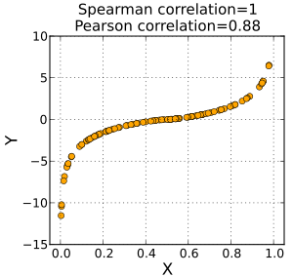
Spearman Rank Correlation (Spearman’s ρ)
Related to Pearson’s correlation coefficient r
measures linear correlation
Spearman’s ρ looks at the relative order of values (rank) rather than the actual value itself
Measures monotonicity: as [x] increases, is [y] always increasing/decreasing?
For each point, as x increases, y increases as well (even if it varies by how much), so it is monotonically increasing.
Therefore, Spearman’s ρ = 1 (if monotonically decreasing, then Spearman’s ρ = -1)
Note that the plotted data is clearly non-linear, which is why Pearson’s r ≠ 1
Spearman’s ρ is suited to our analysis since we do not know if sirolimus concentration is linearly related to any of the biomarkers or if the biomarkers are linearly related to each other.
Notes:
https://en.wikipedia.org/wiki/Spearman%27s_rank_correlation_coefficient
https://en.wikipedia.org/wiki/Pearson_correlation_coefficient

Slide 8
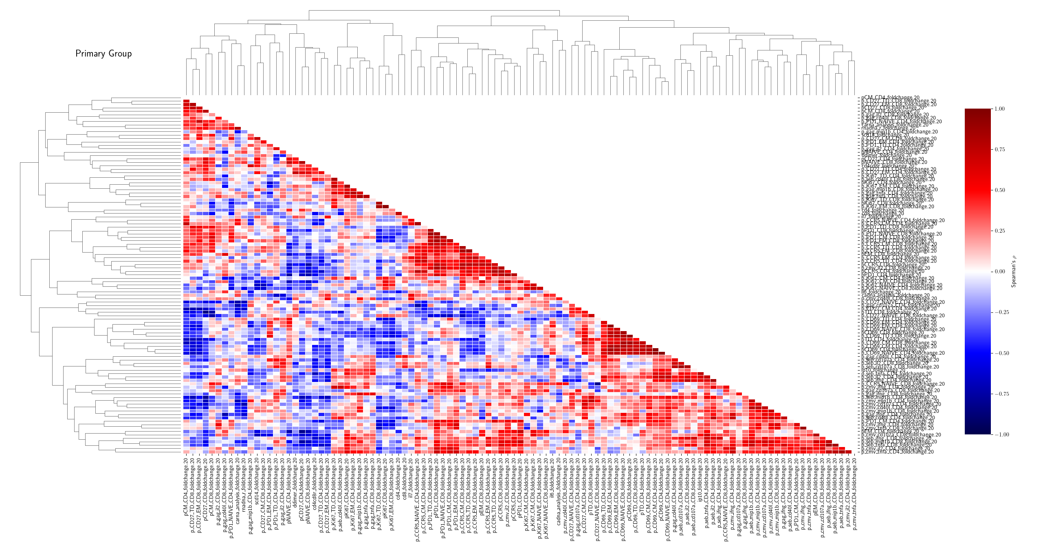
Spearman’s ρ Correlation Matrix: Biomarker vs. Biomarker

Slide 9
Heatmaps
Used fold change instead of raw data to account for differences in biomarker value ranges and units
Ex. biomarker A ranges from 0-100%, biomarker B ranges from 5-10 ng/mL
Fold change will scale the data down and use the same units (number of folds) so that they are more comparable
Ordered individuals by exposure metric to visually see trends
Clustered the biomarkers together to see which ones are similar
Distance metric: standardized Euclidean distance
Has the advantage of normalizing over variance, which reduces the effect of having a wide range/high variance
Ex. with [1, 3, 5], [1, 2, 5], and [1, 10, 18], normal Euclidean distance will not cluster the three together, but standardized Euclidean distance will.

Slide 10
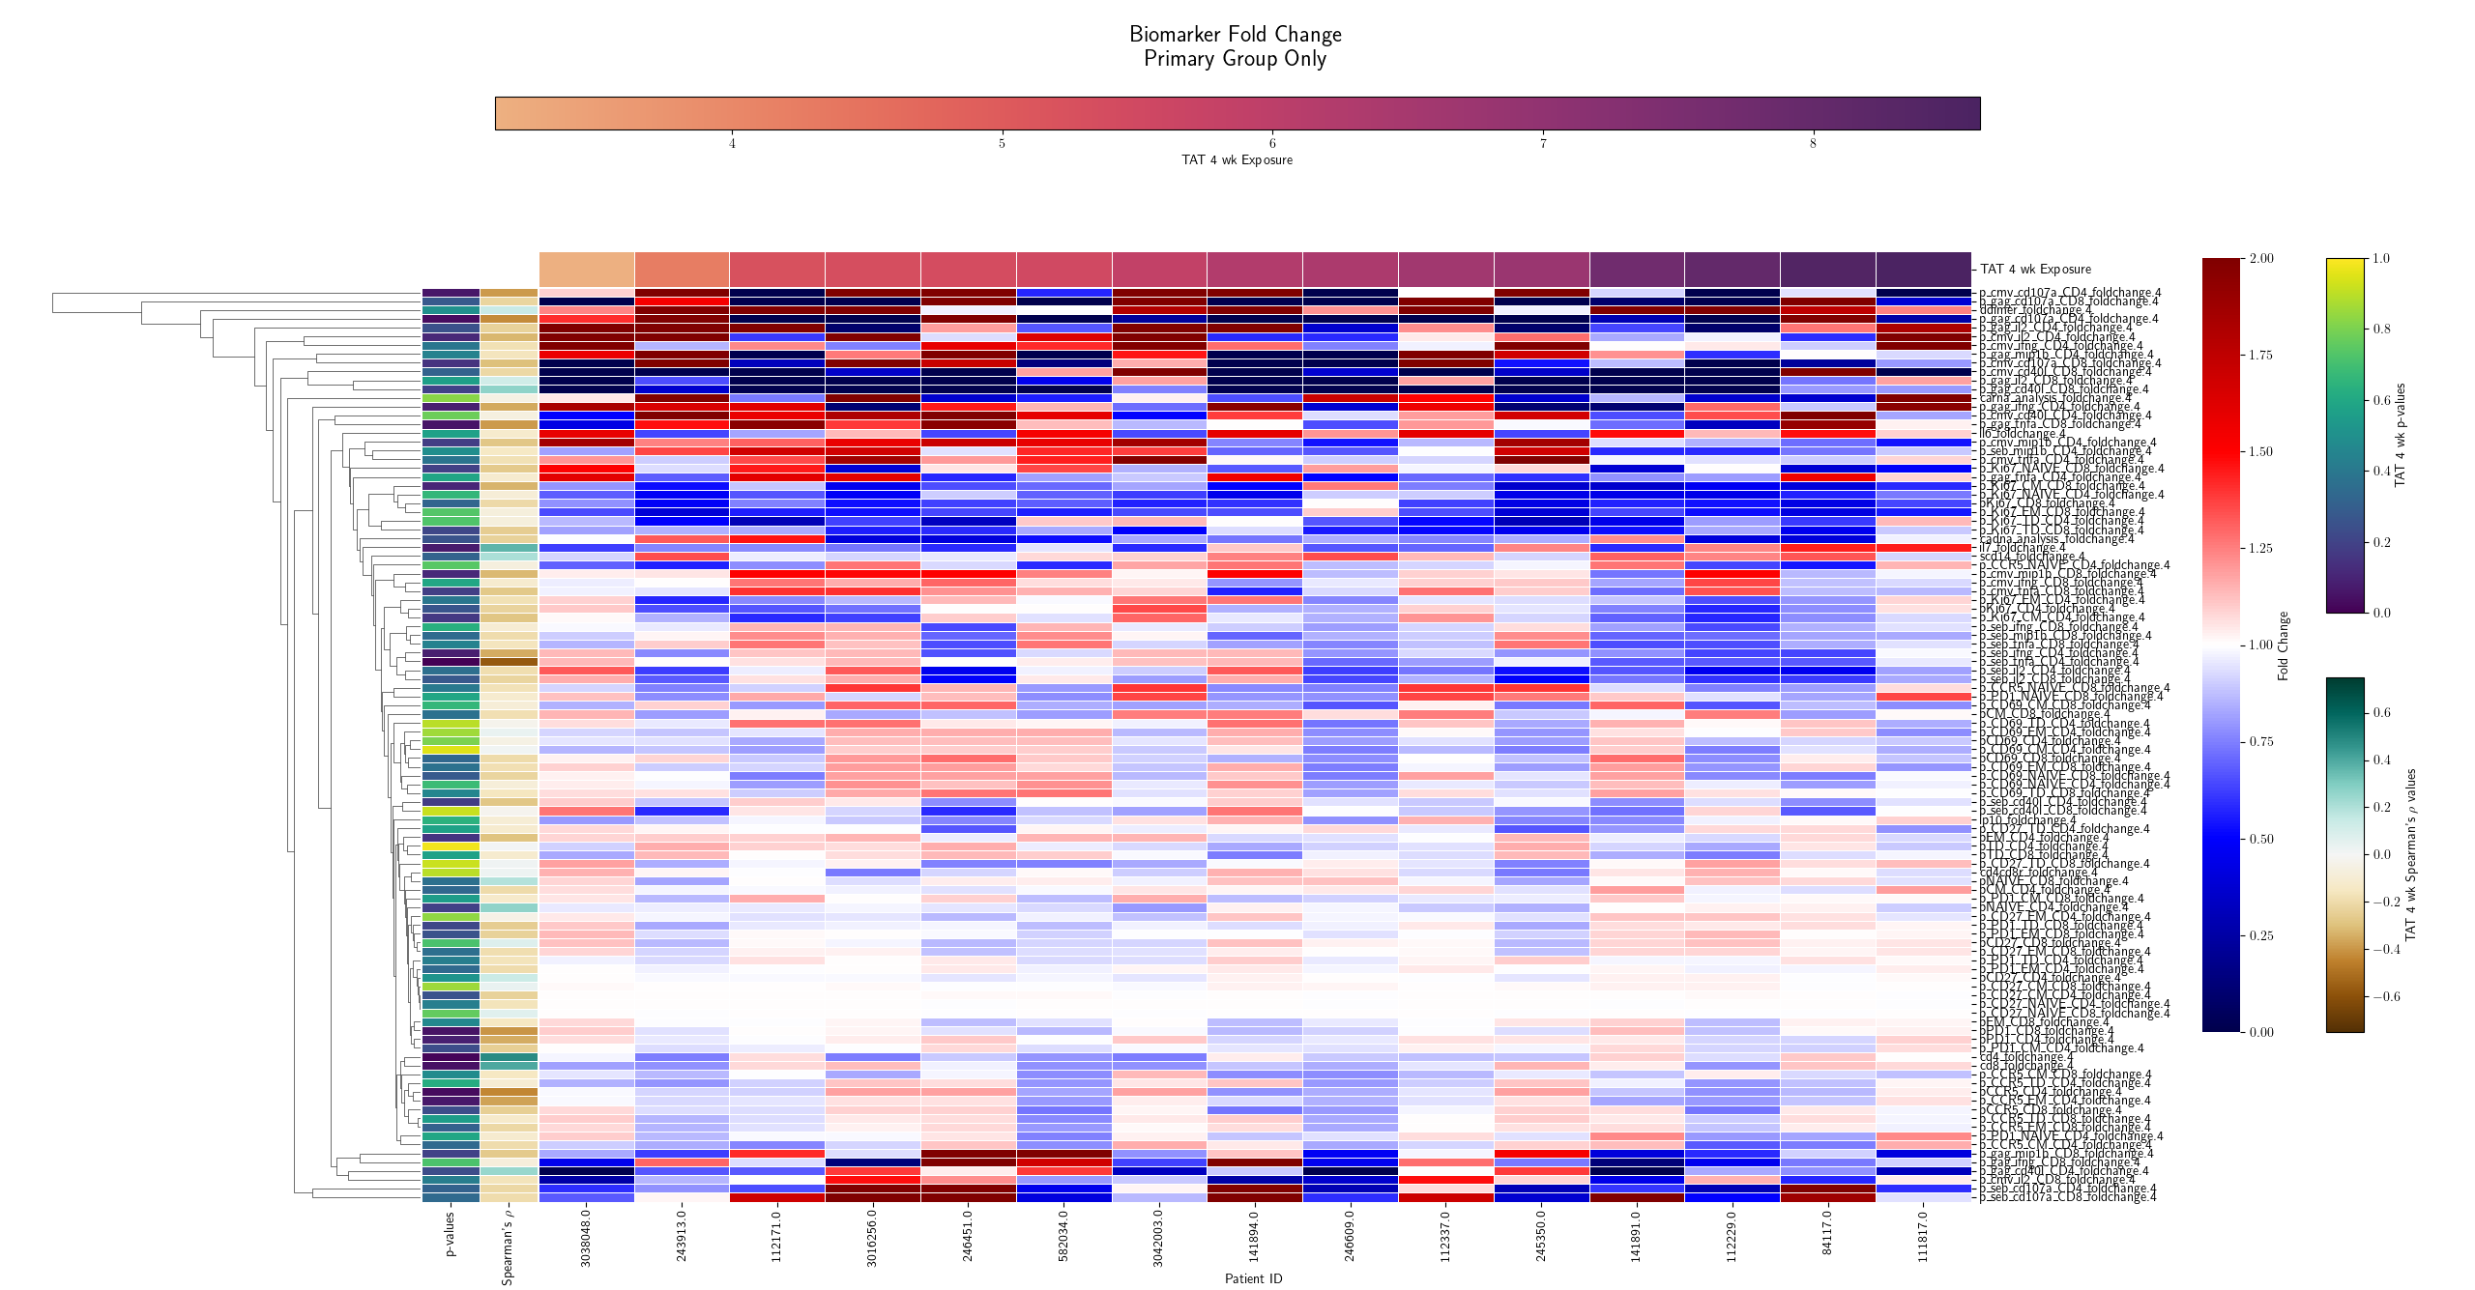

Slide 11
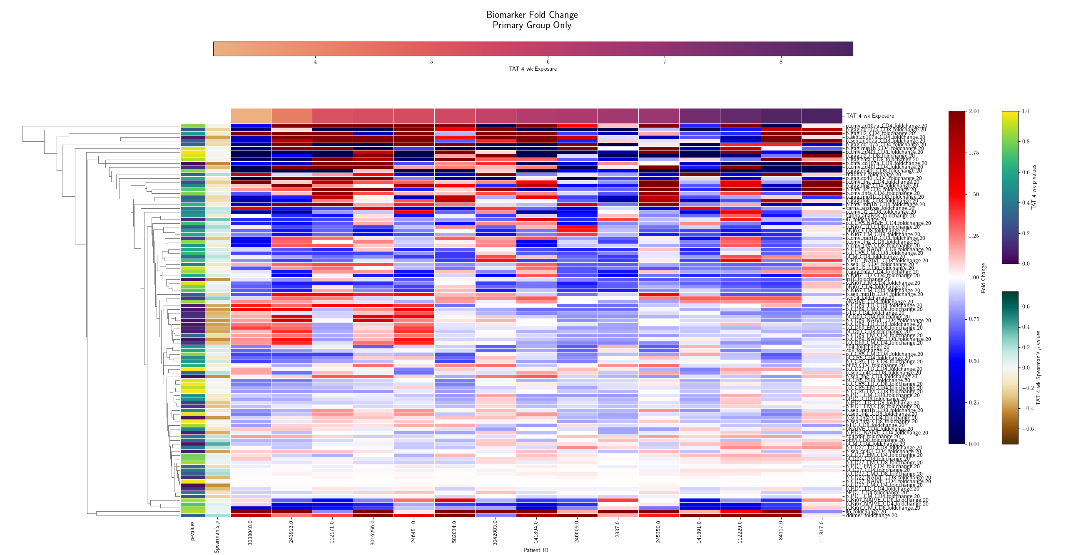

Slide 12
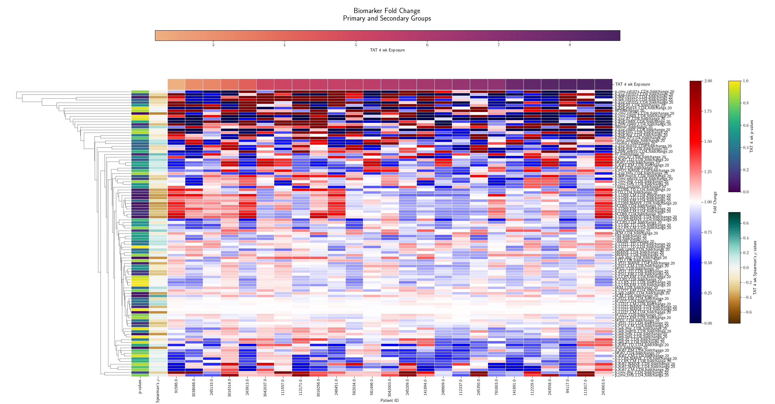

Slide 13
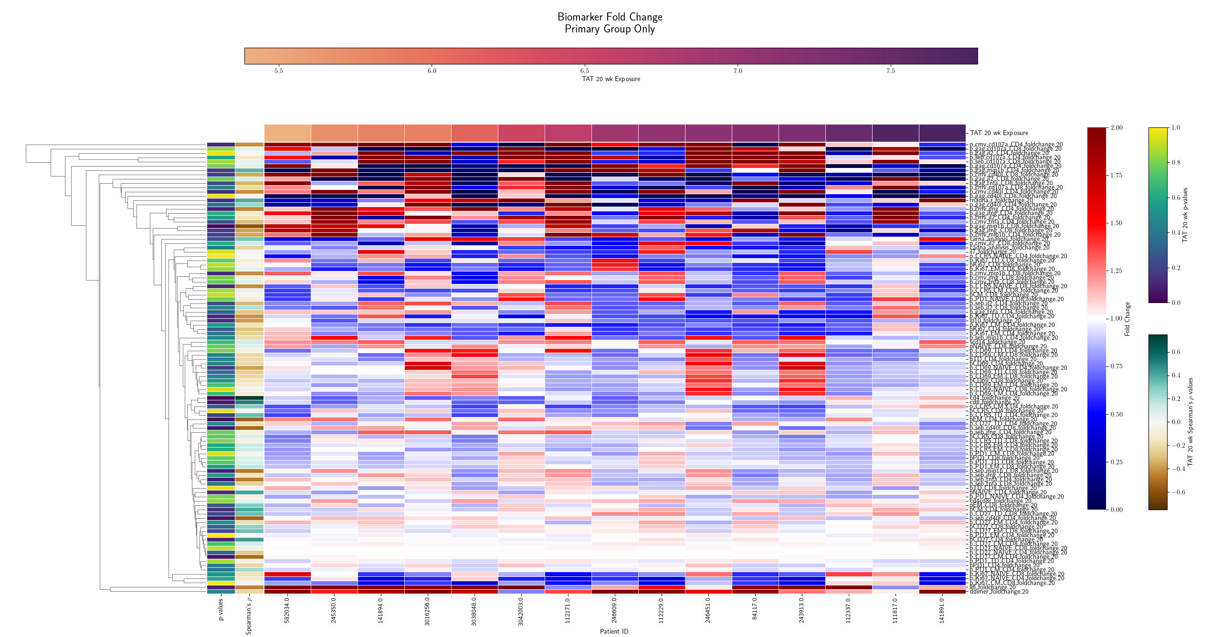

Slide 14
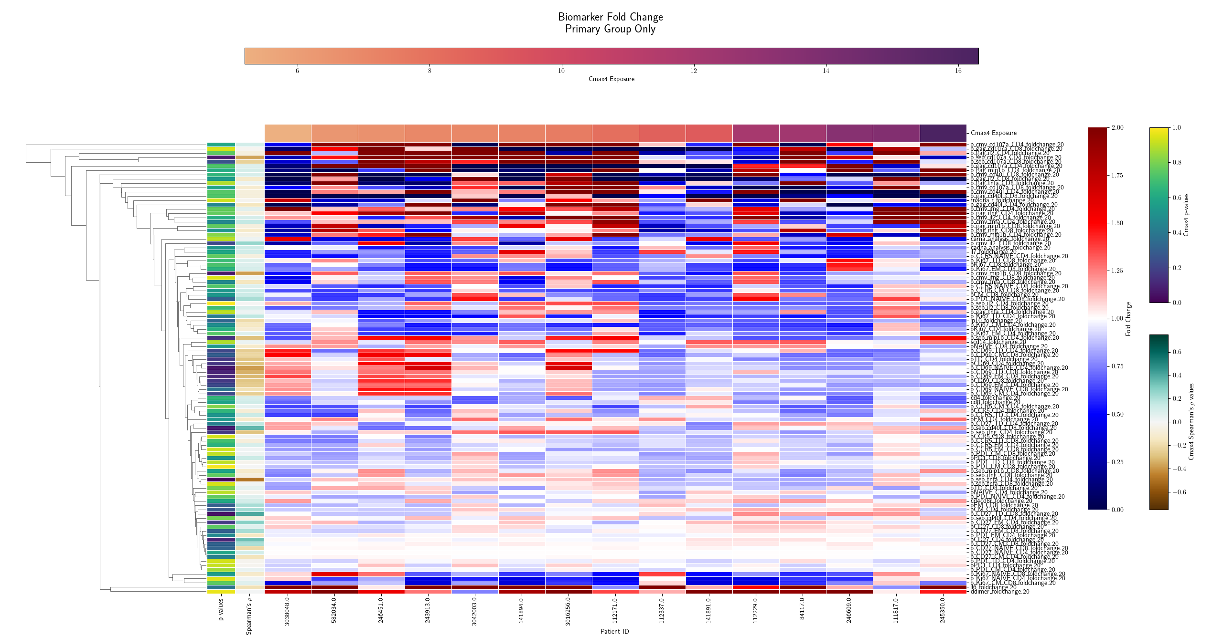

Slide 15
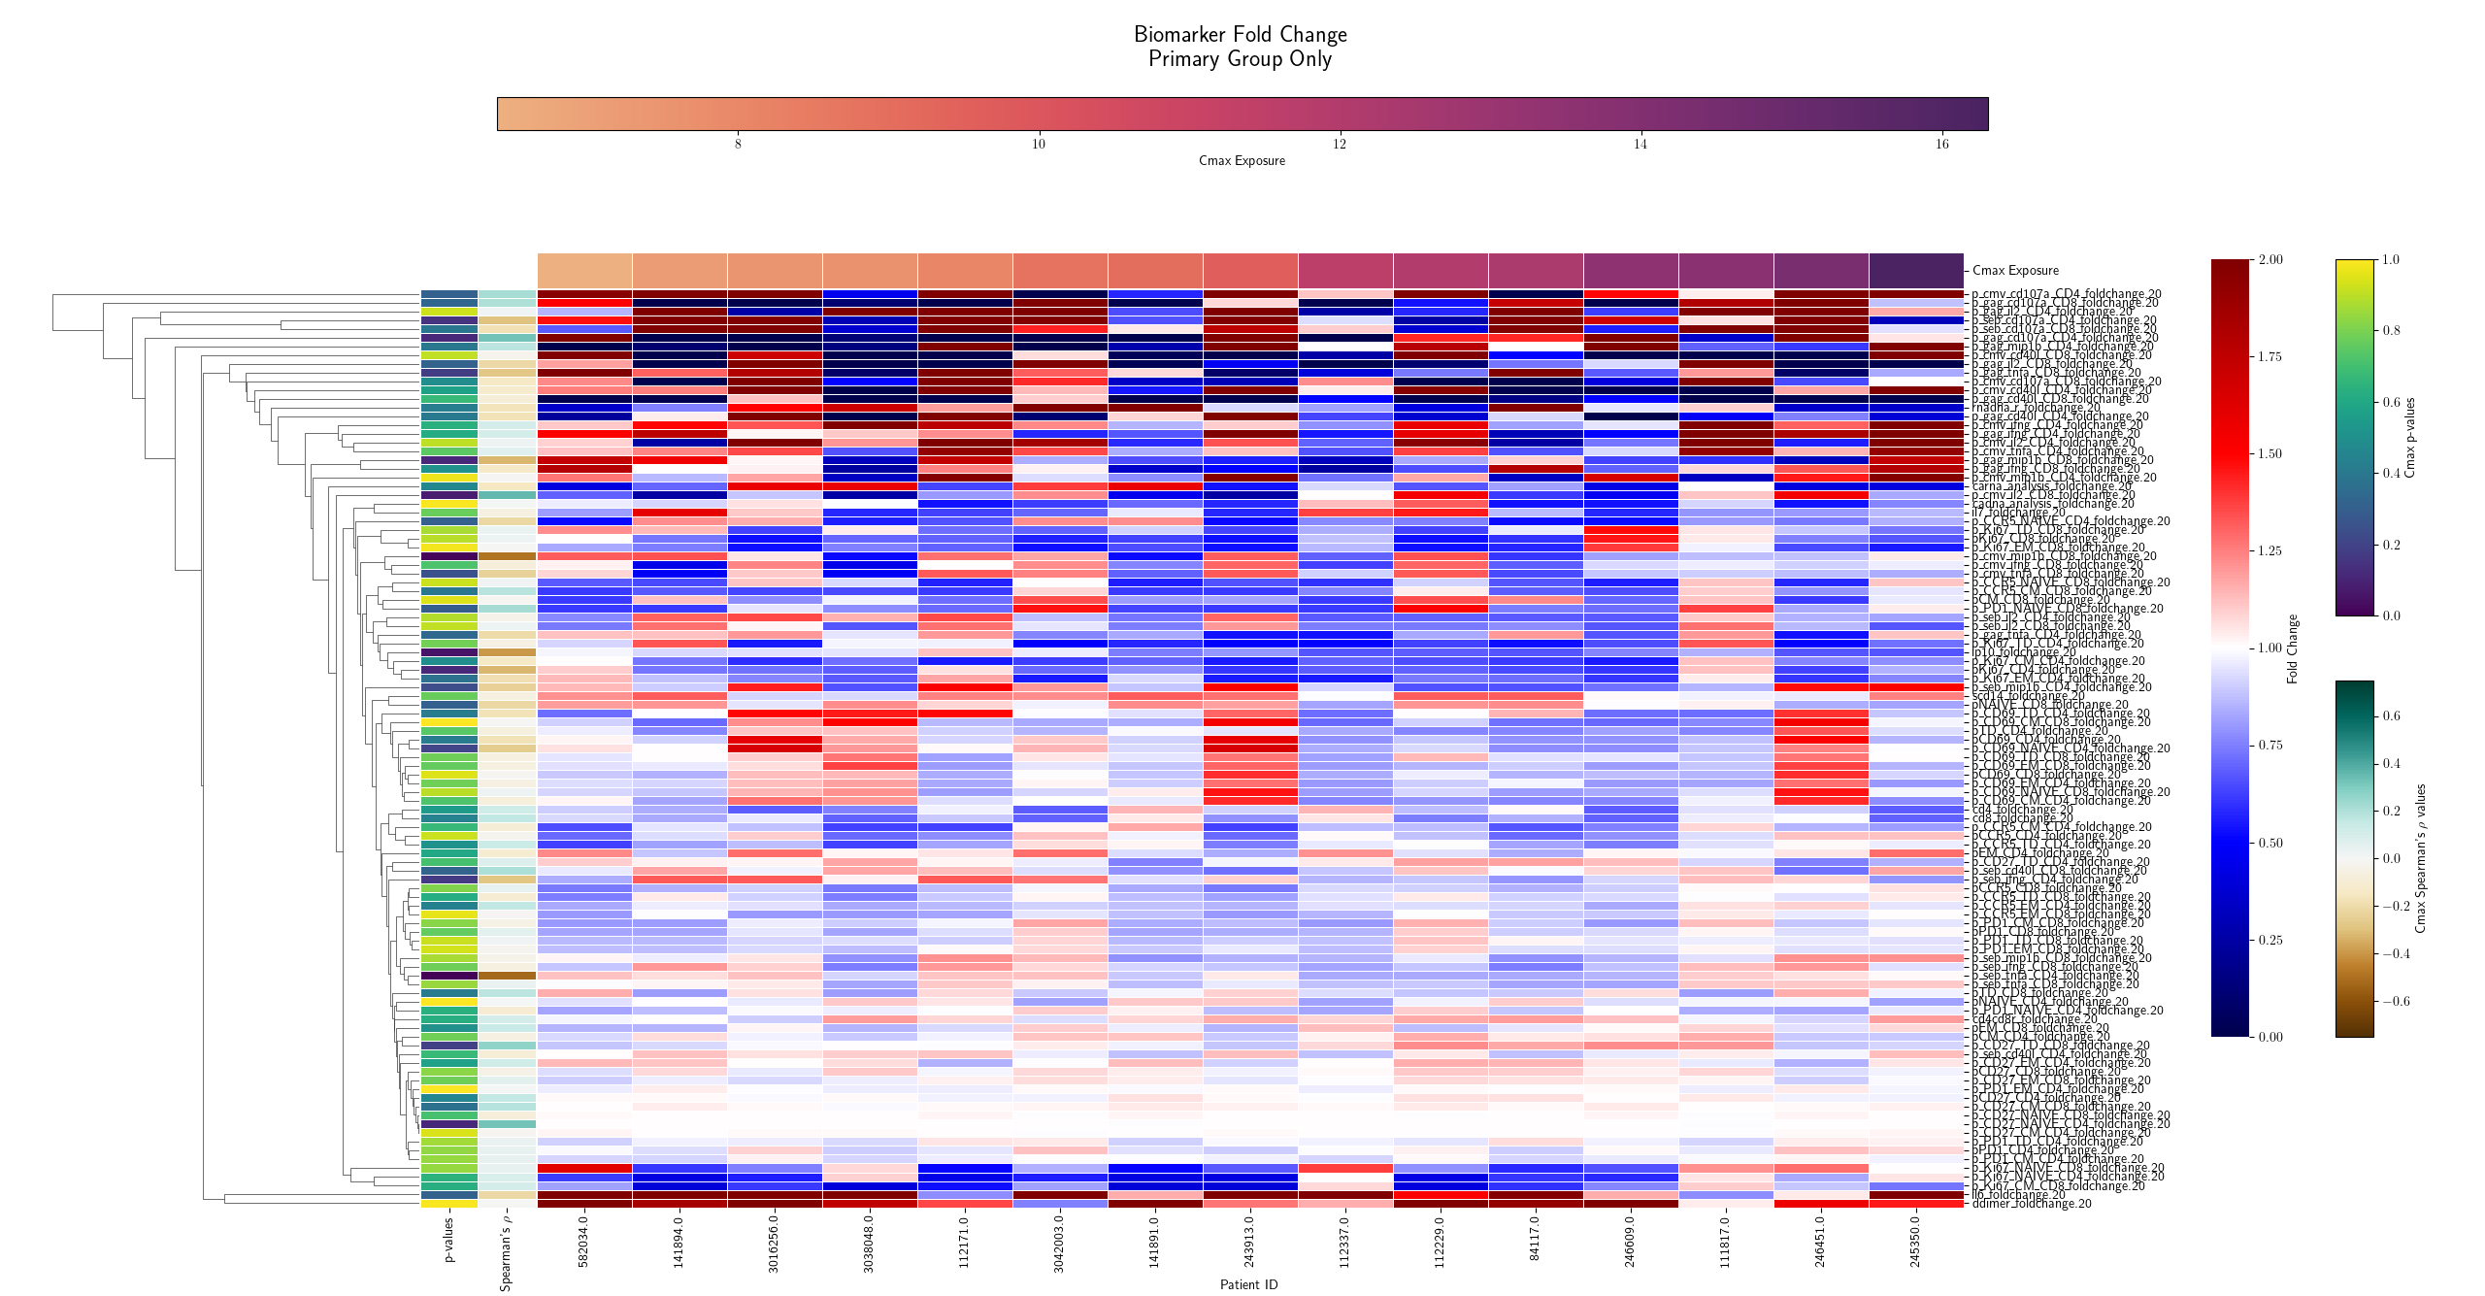

Slide 16
Future Directions
Find a better way to normalize the fold change and distance metrics for clustering
Find a better way to exclude outliers from the dataset
Go through each significant biomarker and see what they represent and how they affect HIV reservoir levels

Slide 17
Acknowledgments
Dr. Amelia Deitchman
Drug Research Unit, UCSF Clinical Pharmacy
AIDS Clinical Trials Group (ACTG)
The National Institute of Allergy and Infections Disease
ViiV Healthcare

